Slide 1
Optimization for ML
CSN-382

Slide 2

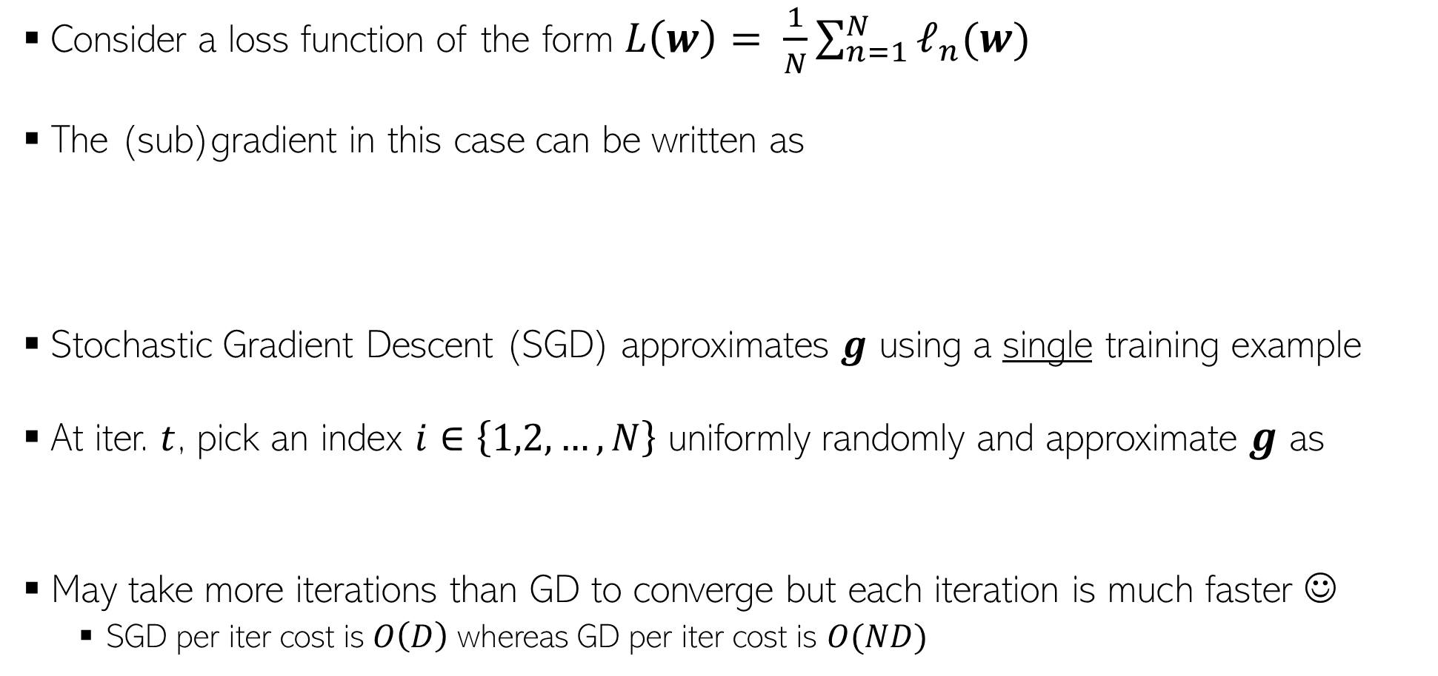

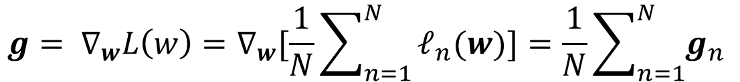
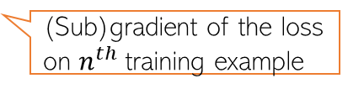
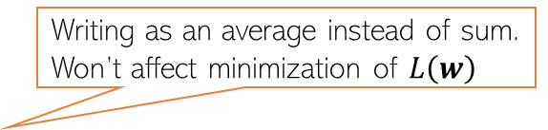

Stochastic Gradient Descent (SGD)
Writing as an average instead of sum. Won’t affect minimization of $L\left(w\right)$
Consider a loss function of the form $L\left(w\right)= \frac{1}{N}\sum_{n=1}^{N}{ℓ_{n}(w)}$
The (sub)gradient in this case can be written as
Stochastic Gradient Descent (SGD) approximates $g$ using a single training example
At iter. $t$, pick an index $i∈\left\{1,2,…,N\right\}$ uniformly randomly and approximate $g$ as
May take more iterations than GD to converge but each iteration is much faster ☺
SGD per iter cost is$O\left(D\right)$ whereas GD per iter cost is $O(ND)$
Expensive to compute – requires doing it for all the training examples in each iteration ☹
$${g= ∇}_{w}L\left(w\right)=∇_{w}[\frac{1}{N}\sum_{n=1}^{N}{ℓ_{n}(w)]=\frac{1}{N}\sum_{n=1}^{N}{g_{n} }}$$
(Sub)gradient of the loss on $n^{th}$training example
Can show that $g_{i}$ is an unbiased estimate of $g$, i.e.,$𝔼\left[g_{i}\right]=g$
$$g≈g_{i}=∇_{w}ℓ_{i}(w)$$

Slide 3
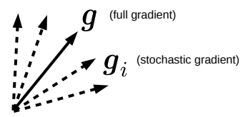
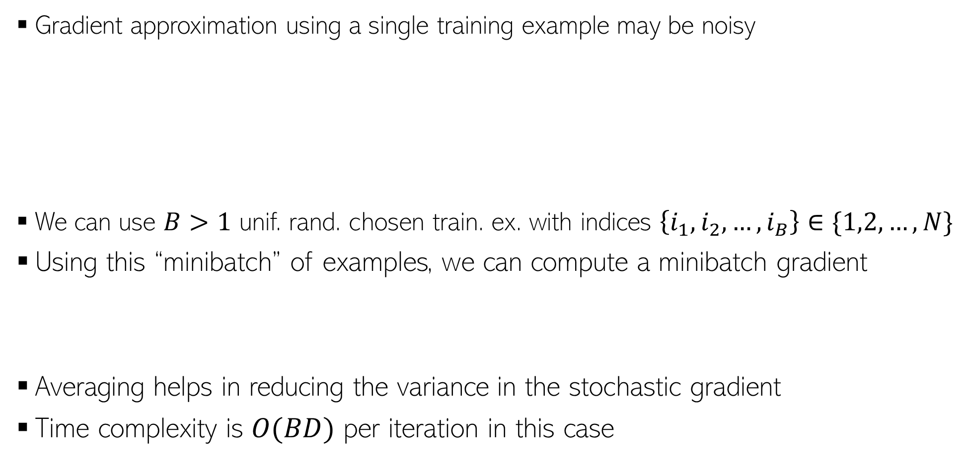

Minibatch SGD
Gradient approximation using a single training example may be noisy
We can use $B>1$ unif. rand. chosen train. ex. with indices $\left\{i_{1},i_{2},…,i_{B}\right\}∈\{1,2,…,N\}$
Using this “minibatch” of examples, we can compute a minibatch gradient
Averaging helps in reducing the variance in the stochastic gradient
Time complexity is $O(BD)$ per iteration in this case
The approximation may have a high variance – may slow down convergence, updates may be unstable, and may even give sub-optimal solutions (e.g., local minima where GD might have given global minima)
$$g≈\frac{1}{B}\sum_{b=1}^{B}{g_{i_{b}}}$$

Slide 4
Constrained Optimization

Slide 5


Projected Gradient Descent
Consider an optimization problem of the form
Projected GD is very similar to GD with an extra projection step
Each iteration $t$ will be of the form
Perform update: $z^{(t+1)}= w^{(t)}−η_{t}g^{(t)}$
Check if $z^{(t+1)}$ satisfies constraints
If $z^{(t+1)}∈𝒞,$set $w^{(t+1)}$= $z^{(t+1)}$
If $z^{(t+1)}∉𝒞,$ project as $w^{(t+1)}$= $Π_{𝒞}[z^{(t+1)}]$
$w_{opt}= {arg min}_{w∈𝒞}$ $L(w)$
Projection
step
Projection operator

Slide 6
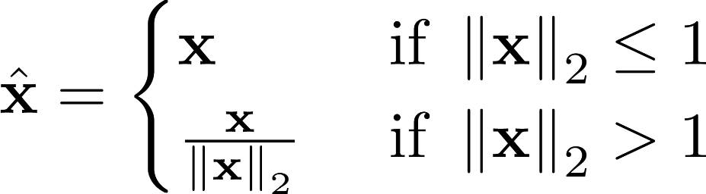
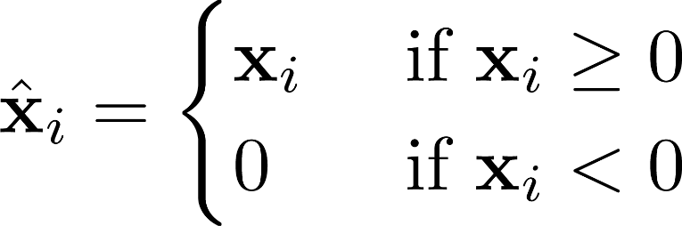



Projected GD: How to Project?
Here projecting a point means finding the “closest” point from the constraint set
For some sets $𝒞$, the projection step is easy
$Π_{𝒞}\left[z\right]={arg min}_{w∈𝒞}$ ${\left\|z−w\right\|}^{2}$
Projected GD commonly used only when the projection step is simple and efficient to compute
$𝒞$: Unit radius $ℓ_{2}$ball
$𝒞$: Set of non-negative reals
(0,1)
(1,0)
Projection = Normalize to unit Euclidean length vector
Projection = Set each negative entry in $z$ to be zero

Slide 7
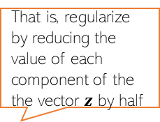

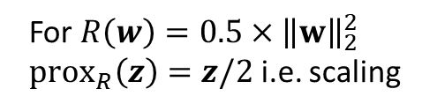

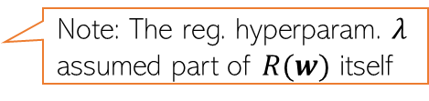

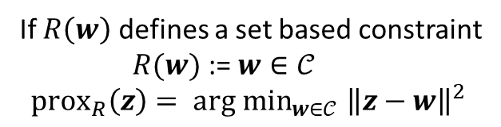
Proximal Gradient Descent
Consider minimizing a regularized loss function of the form
Proximal GD popular when regularizer $R(w)$ is non-differentiable
Basic idea: Do GD on $L(w)$ and use a prox. operator to regularize via $R(w)$
For a func. $R$, its prox. operator is ${prox}_{R}\left(z\right)=\arg{\min_{w}\left[R\left(w\right)+\frac{1}{2}{\left\|z−w\right\|}_{2}^{2}\right]}$
${arg min}_{w} L(w) + R(w)$
Note: The reg. hyperparam. $λ$ assumed part of $R(w)$ itself
Proximal GD
Special Cases
That is, regularize by reducing the value of each component of the the vector $z$ by half
Assume reg. loss function of the form $L(w) + R(w)$
Initialize $w$ as $w^{(0)}$
For iteration $t=0,1,2,…$(or until convergence)
Calculate the (sub)gradient of train. Loss (w/o reg.)
$g^{(t)}∈∂L\left(w^{\left(t\right)}\right)$
Set learning rate $η_{t}$
Step 1: $z^{(t+1)}= w^{(t)}−η_{t}g^{(t)}$
Step 2: $w^{(t+1)}={prox}_{R}\left(z^{(t+1)}\right)$
For $R\left(w\right)=0.5×{\left\|w\right\|}_{2}^{2}$
$prox_{R}\left(z\right)=z/2$ i.e. scaling
If $R\left(w\right)$ defines a set based constraint
$R(w)$ := $w∈𝒞$
$$prox_{R}\left(z\right)= {arg min}_{w∈𝒞} {\left\|z−w\right\|}^{2}$$
Prox. GD becomes equivalent to projected GD

Slide 8


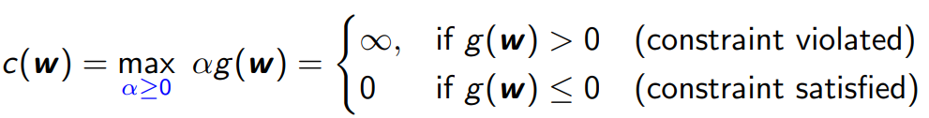
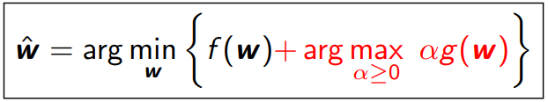
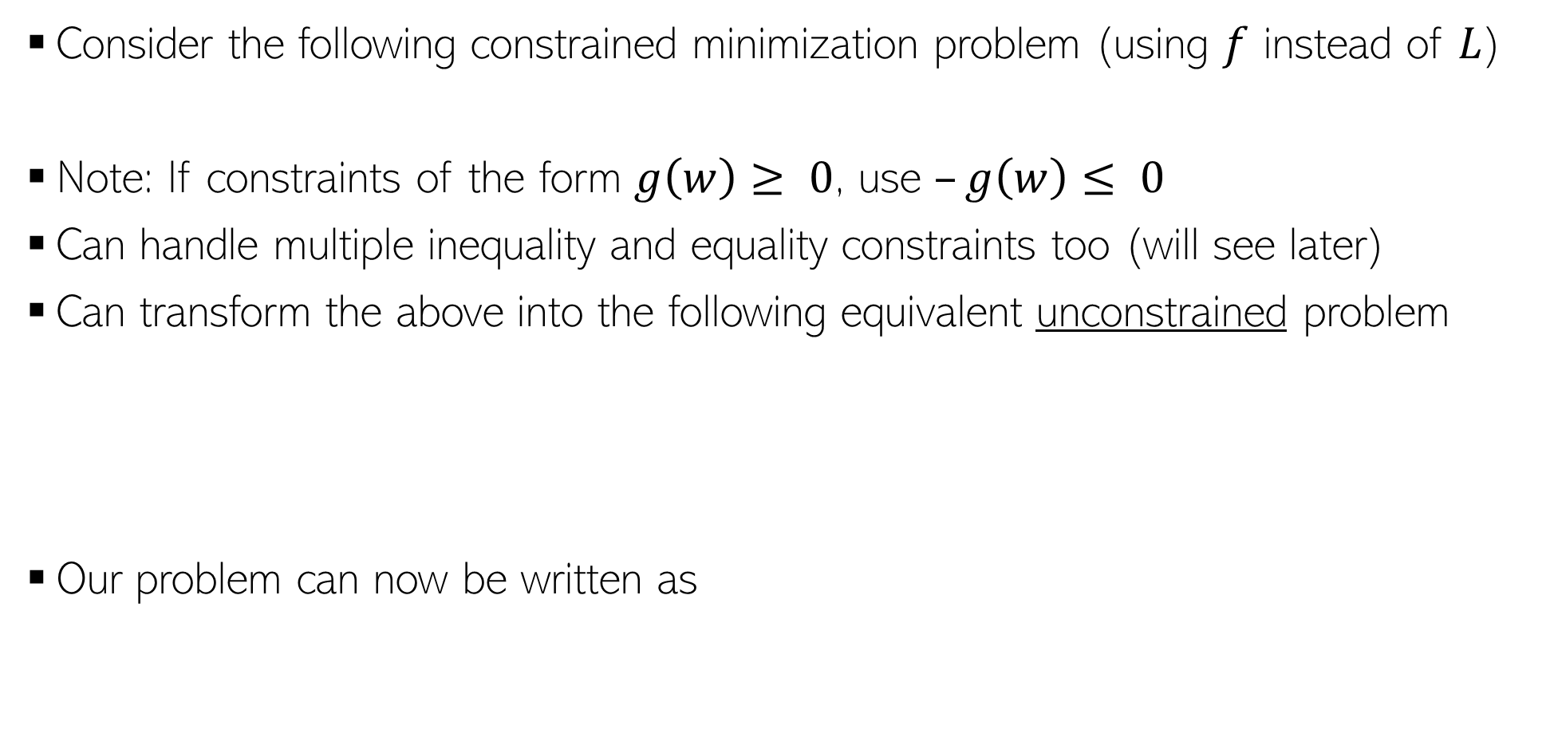
Constrained Opt. via Lagrangian
Consider the following constrained minimization problem (using $f$ instead of $L$)
Note: If constraints of the form $g\left(w\right)≥ 0$, use $–g\left(w\right)≤ 0$
Can handle multiple inequality and equality constraints too (will see later)
Can transform the above into the following equivalent unconstrained problem
Our problem can now be written as

Slide 9
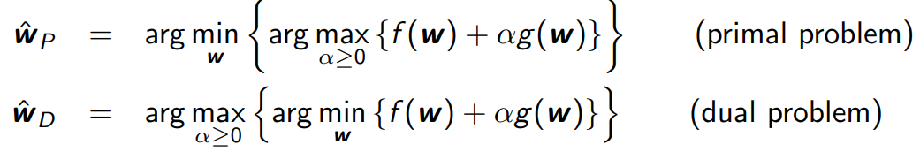


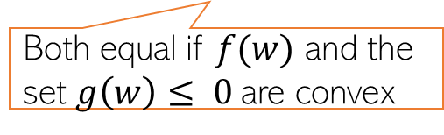
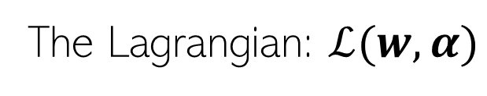
Constrained Opt. via Lagrangian
The Lagrangian: $ℒ(w,α)$
Therefore, we can write our original problem as
The Lagrangian is now optimized w.r.t. $w$ and $α$ (Lagrange multiplier)
We can defined Primal and Dual problem as
Both equal if $f(w)$ and the set $g\left(w\right)≤ 0$are convex
complimentary slackness/Karush-Kuhn-Tucker (KKT) condition

Slide 10
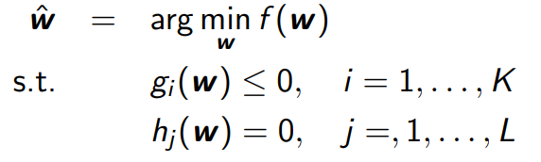
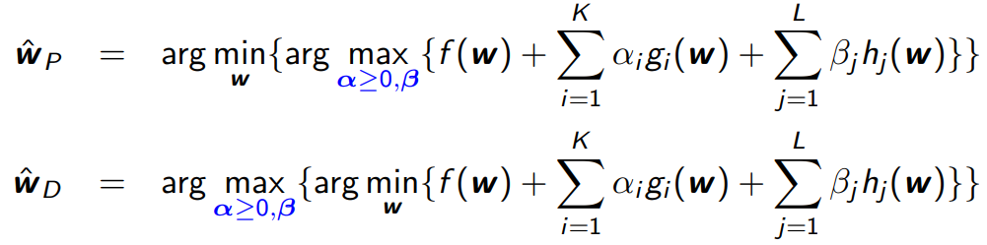

Constrained Opt. with Multiple Constraints
We can also have multiple inequality and equality constraints
Introduce Lagrange multipliers $α=[α_{1},α_{2},…,α_{K}]$ and $β=\left[β_{1},β_{2},…,β_{L}\right]$
The Lagrangian based primal and dual problems will be

Slide 11
Some other useful optimization methods

Slide 12
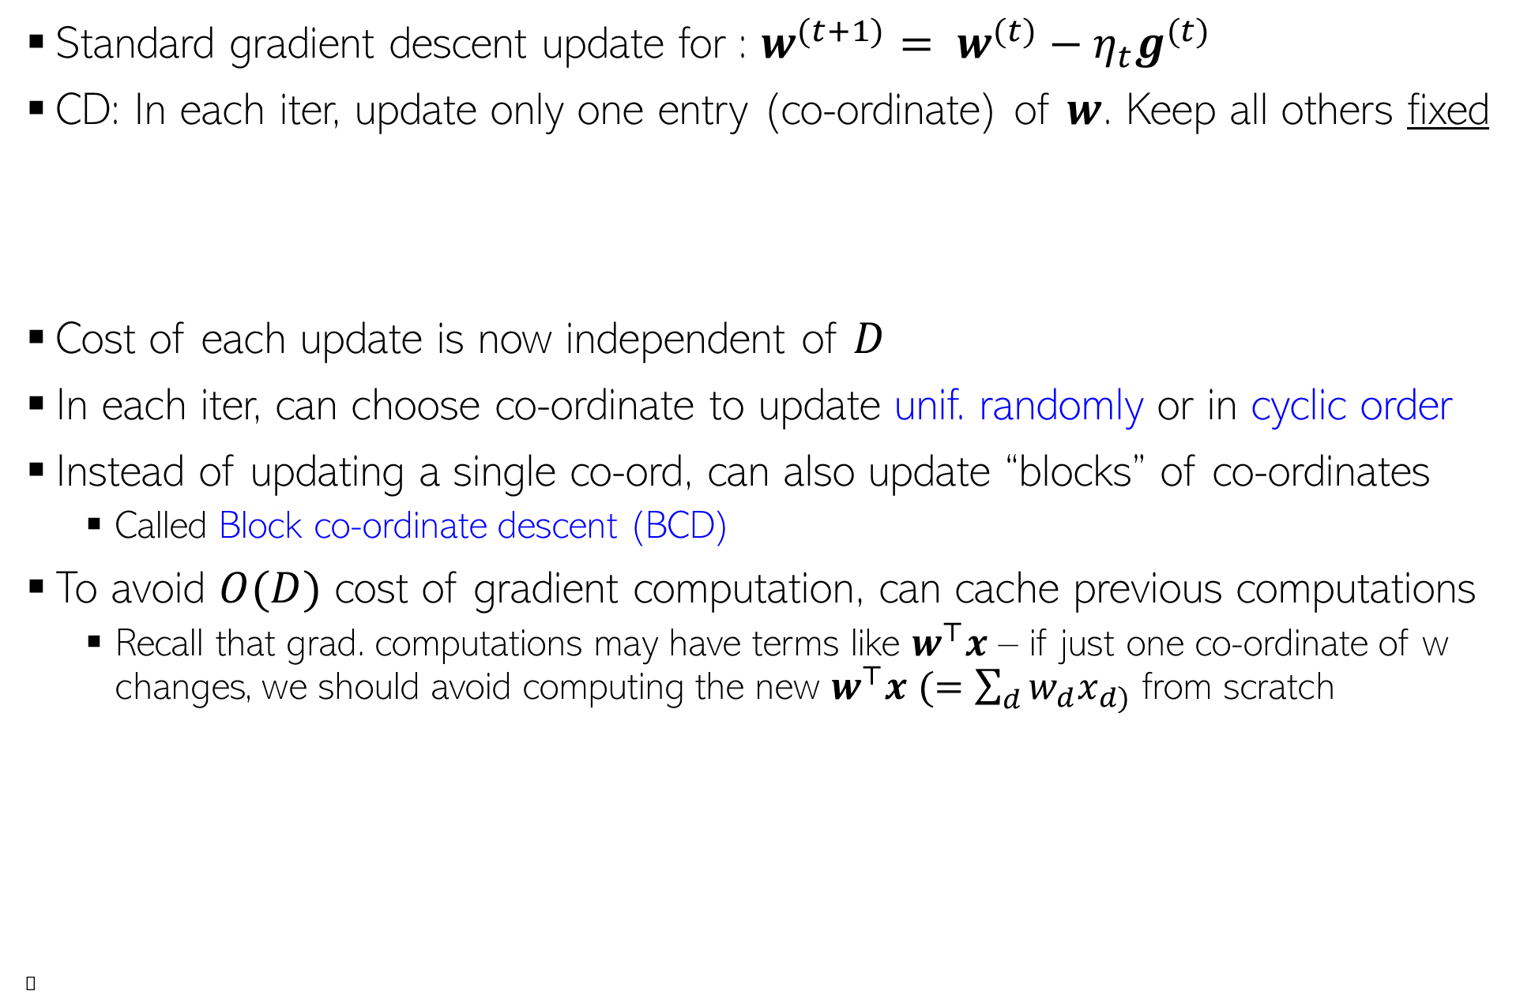
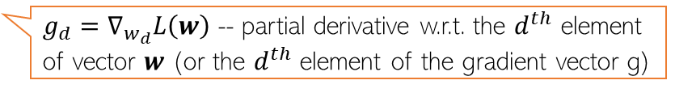
Co-ordinate Descent (CD)
Standard gradient descent update for : $w^{(t+1)}= w^{(t)}−η_{t}g^{(t)}$
CD: In each iter, update only one entry (co-ordinate) of $w$. Keep all others fixed
Cost of each update is now independent of $D$
In each iter, can choose co-ordinate to update unif. randomly or in cyclic order
Instead of updating a single co-ord, can also update “blocks” of co-ordinates
Called Block co-ordinate descent (BCD)
To avoid $O(D)$ cost of gradient computation, can cache previous computations
Recall that grad. computations may have terms like $w^{⊤}x$ – if just one co-ordinate of w changes, we should avoid computing the new $w^{⊤}x$ $(=\sum_{d}{w_{d}x_{d)}}$ from scratch
Ⓣ
$w_{d}^{(t+1)}= w_{d}^{(t)}−η_{t}g_{d}^{(t)}$ $d∈\{1,2,…,D\}$
$g_{d}=∇_{w_{d}}L\left(w\right)$ -- partial derivative w.r.t. the $d^{th}$ element of vector $w$ (or the $d^{th}$ element of the gradient vector g)
=

Slide 13

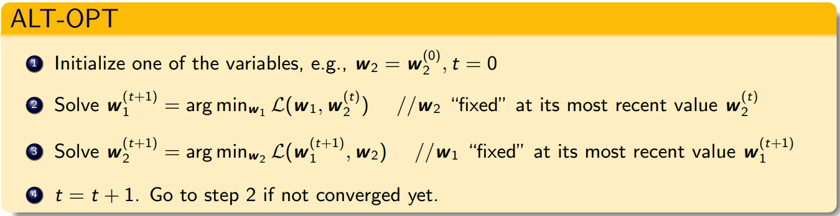
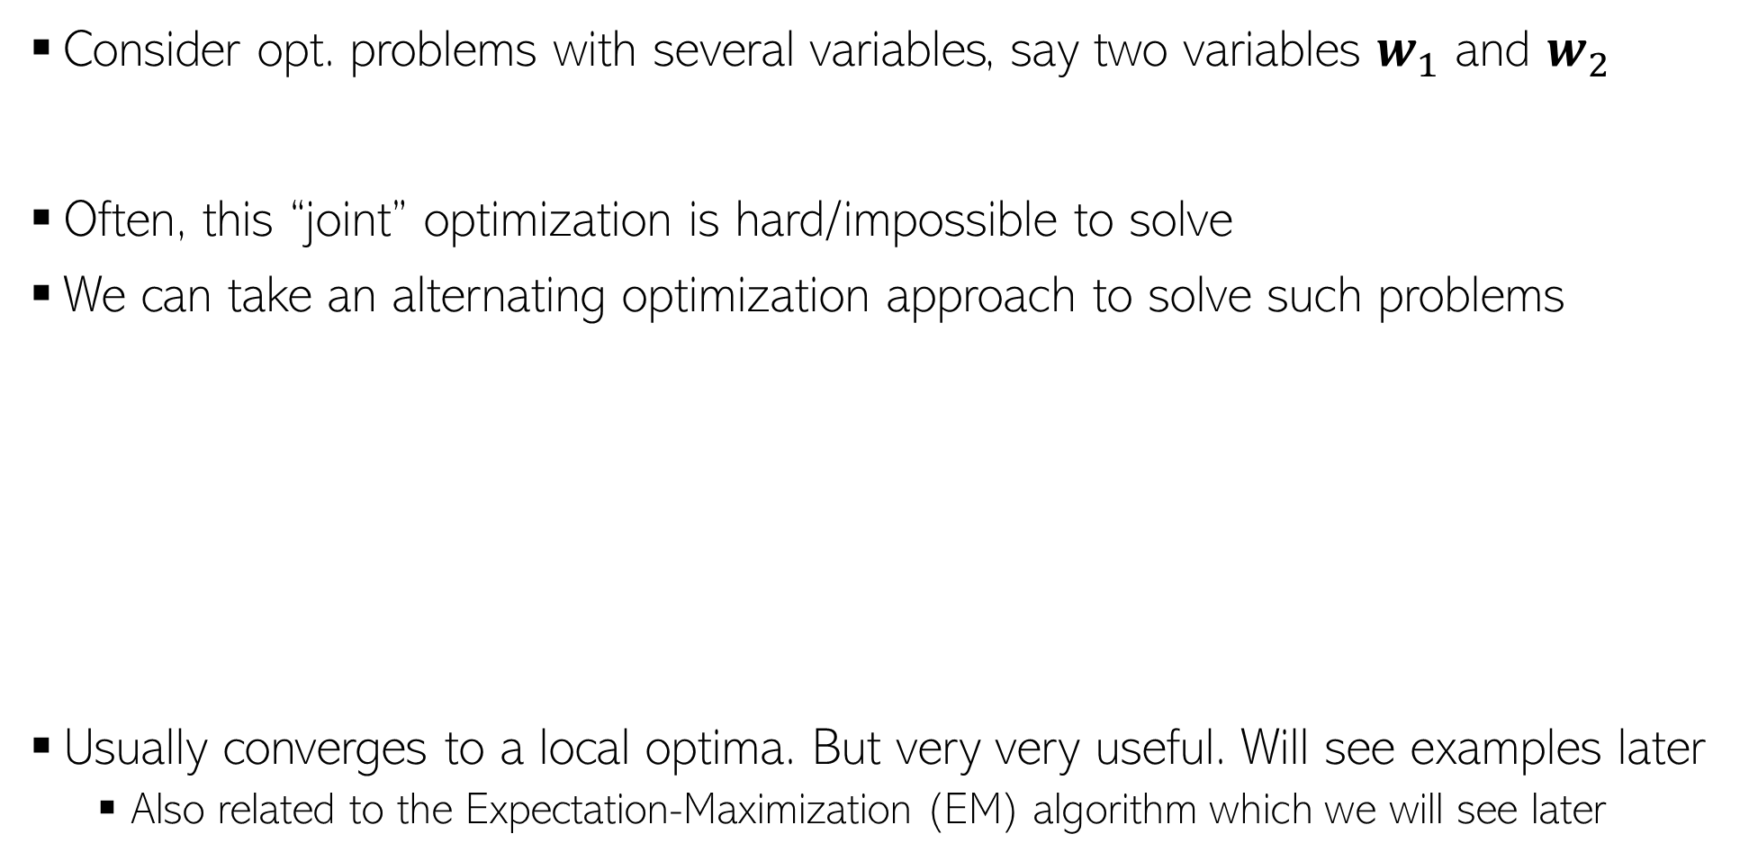
Alternating Optimization (ALT-OPT)
Consider opt. problems with several variables, say two variables $w_{1}$ and $w_{2}$
Often, this “joint” optimization is hard/impossible to solve
We can take an alternating optimization approach to solve such problems
Usually converges to a local optima. But very very useful. Will see examples later
Also related to the Expectation-Maximization (EM) algorithm which we will see later

Slide 14
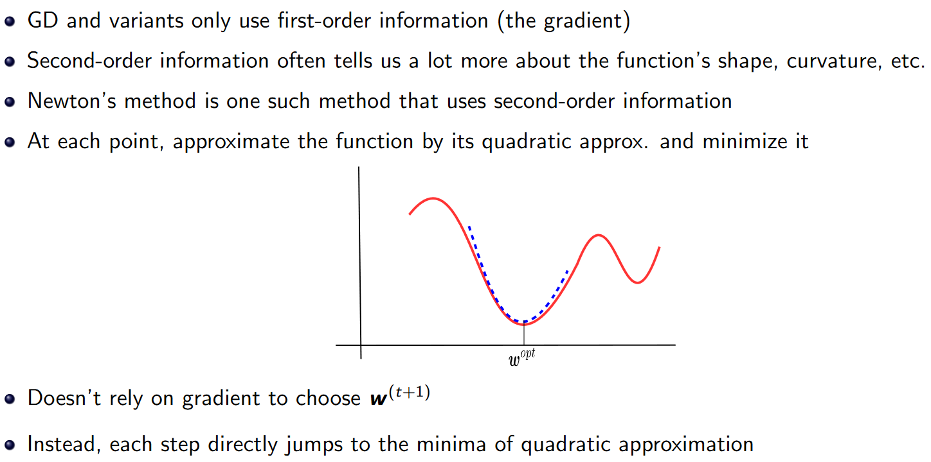
Newton’s Method

Slide 15
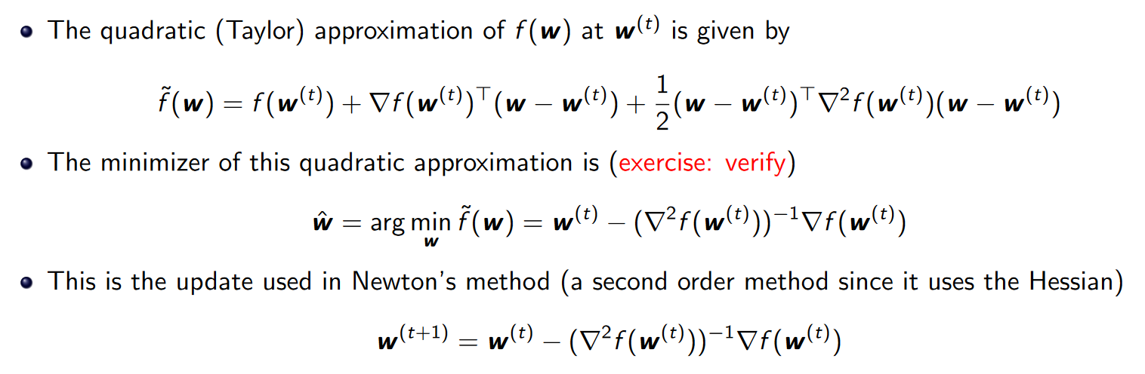
Newton’s Method

Slide 16
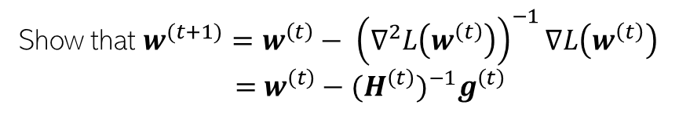





Newton’s Method
Unlike GD and its variants, Newton’s method uses second-order information (second derivative, a.k.a. the Hessian)
At each point $w^{(t)}$, minimize the quadratic (second-order) approx. of $L(w)$
$w^{(t+1)}={arg min}_{w}$ [$L\left(w^{\left(t\right)}\right)+∇{L\left(w^{\left(t\right)}\right)}^{⊤}\left(w−w^{\left(t\right)}\right)+\frac{1}{2}{(w−w^{\left(t\right)})}^{⊤}∇^{2}L\left(w^{\left(t\right)}\right)$ $(w−w^{\left(t\right)})$]
$$L(w)$$
Show that $w^{(t+1)}=w^{\left(t\right)}− {\left(∇^{2}L\left(w^{\left(t\right)}\right)\right)}^{−1}∇L\left(w^{\left(t\right)}\right)$
$=$ $w^{\left(t\right)}−{{(H}^{\left(t\right)})}^{−1}g^{\left(t\right)}$
Converges much faster than GD (very fast for convex functions). Also no “learning rate”. But per iteration cost is slower due to Hessian computation and inversion
Faster versions of Newton’s method also exist, e.g., those based on approximating Hessian using previous gradients (see L-BFGS which is a popular method)
$$w^{(1)}$$
$$w_{opt}$$
$$w$$

Slide 17
Coming up next
Some practical issue in optimization for ML
Wrapping up the discussion of optimization techniques

